Slide 1

LLM Engineering
MASTER AI & LARGE LANGUAGE MODELS

Slide 2

DAY 4
Another important level-up
What you can now do
Overview of transformers and key terminology
Confidently code with Chat Completions API
Build an AI Chatbot Assistant including an interactive UI
After today you'll be able to
Define Tools
Give common use cases for Tools
Code an AI Assistant that incorporates Tools

Slide 3

DEFINING TOOLS
Tools
Allows Frontier models to connect with external functions
Richer responses by extending knowledge
Ability to carry out actions within the application
Enhanced capabilities, like calculations
BUT WAIT
So we’re going to give an LLM the ability to run code
This sounds spooky!
OpenAI is going to reach into my computer??

Slide 4



Tool Calling in Theory
An LLM Decides to run code on my computer
Prompt
Response
Code
LLM
EXECUTE
Tool

Slide 5
Tool Calling in Practice
An LLM Only Generates Tokens! Our code calls the tool
Prompt
Response
Code
LLM
EXECUTE
Tool

Slide 6
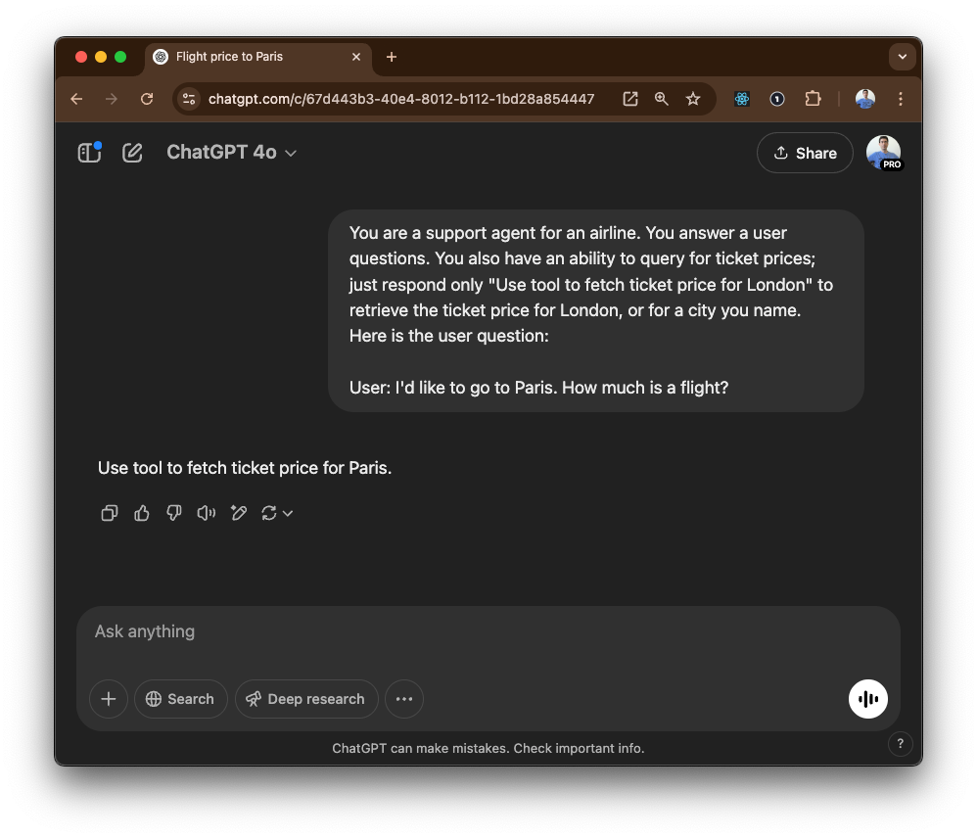
Behold Tool Calling

Slide 7




Common Use Cases For Tools
Tools can enable assistants to:
Fetch data or add knowledge or context
Take action, like booking a meeting
Perform calculations
or run code
Modify the UI
And two other ways to use tools that form basis of Agentic AI:
A tool can be used to make another call to an LLM
A tool can be used to track a ToDo list and track progress towards a goal

Slide 8
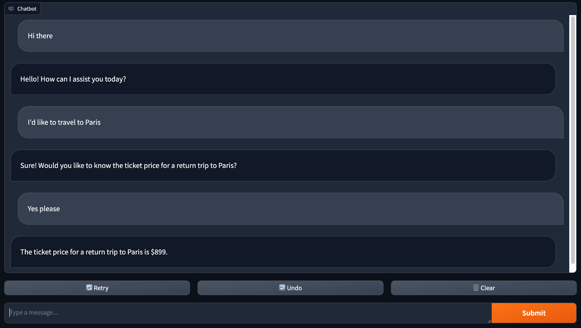
The Informed Airline Customer Support Agent

Slide 9

COMING UP
Tomorrow we take this to the next level
What you can now do
Overview of transformers and key terminology
Confidently code with the Chat Completions API
Build an AI Assistant using Tools for enhanced expertise
Tomorrow will complete week 2
Describe Agents
Explain how Agents can carry out sequential activities
Complete a multi-modal AI Assistant with Agents and Tools

